Slide 1
Python for Data Analysis

Slide 2
Python Libraries for Data Science
Many popular Python toolboxes/libraries:
NumPy
SciPy
Pandas
SciKit-Learn
Visualization libraries
matplotlib
Seaborn
and many more …

Slide 3

Python Libraries for Data Science
NumPy:
introduces objects for multidimensional arrays and matrices, as well as functions that allow to easily perform advanced mathematical and statistical operations on those objects
provides vectorization of mathematical operations on arrays and matrices which significantly improves the performance
many other python libraries are built on NumPy
Link: http://www.numpy.org/

Slide 4

Python Libraries for Data Science
SciPy:
collection of algorithms for linear algebra, differential equations, numerical integration, optimization, statistics and more
part of SciPy Stack
built on NumPy
Link: https://www.scipy.org/scipylib/

Slide 5

Python Libraries for Data Science
Pandas:
adds data structures and tools designed to work with table-like data (similar to Series and Data Frames in R)
provides tools for data manipulation: reshaping, merging, sorting, slicing, aggregation etc.
allows handling missing data
Link: http://pandas.pydata.org/

Slide 6

Python Libraries for Data Science
SciKit-Learn:
provides machine learning algorithms: classification, regression, clustering, model validation etc.
built on NumPy, SciPy and matplotlib
Link: http://scikit-learn.org/

Slide 7

Python Libraries for Data Science
matplotlib:
python 2D plotting library which produces publication quality figures in a variety of hardcopy formats
a set of functionalities similar to those of MATLAB
line plots, scatter plots, barcharts, histograms, pie charts etc.
relatively low-level; some effort needed to create advanced visualization
Link: https://matplotlib.org/

Slide 8
Python Libraries for Data Science
Seaborn:
based on matplotlib
provides high level interface for drawing attractive statistical graphics
Similar (in style) to the popular ggplot2 library in R
Link: https://seaborn.pydata.org/

Slide 9
Pandas

Slide 10
Loading Python Libraries
In [ ]:
#Import Python Libraries
import numpy as np
import scipy as sp
import pandas as pd
import matplotlib as mpl
import seaborn as sns
Press Shift+Enter to execute the jupyter cell

Slide 11
Introduction to Pandas
It contains data structures and data manipulation tools designed to make data cleaning and analysis fast and easy in Python.
pandas is often used in tandem with numerical computing tools like NumPy and SciPy, analytical libraries like statsmodels and scikit-learn, and data visualization libraries like matplotlib.
pandas adopts significant parts of NumPy’s idiomatic style of array-based computing, especially array-based functions and a preference for data processing without for loops.
While pandas adopts many coding idioms from NumPy, the biggest difference is that pandas is designed for working with tabular or heterogeneous data. NumPy, by contrast, is best suited for working with homogeneous numerical array data.

Slide 12
Introduction to pandas Data Structures
import pandas as pd
from pandas import Series, DataFrame
To get started with pandas, you will need to get comfortable with its two workhorse data structures: Series and DataFrame. While they are not a universal solution for every problem, they provide a solid, easy-to-use basis for most applications.

Slide 13
Series
A Series is a one-dimensional array-like object containing a sequence of values (of similar types to NumPy types) and an associated array of data labels, called its index. The simplest Series is formed from only an array of data:
obj = pd.Series([4, 7, -5, 3])
obj
Output: 0 4
1 7
2 -5
3 3
dtype: int64

Slide 14
Series
Since we did not specify an index for the data, a default one consisting of the integers 0 through N - 1 (where N is the length of the data) is created. You can get the array representation and index object of the Series via its values and index attributes, respectively:
In [13]: obj.values
Out[13]: array([ 4, 7, -5, 3])
In [14]: obj.index # like range(4)
Out[14]: RangeIndex(start=0, stop=4, step=1)

Slide 15
Series
Often it will be desirable to create a Series with an index identifying each data point with a label:
In [15]: obj2 = pd.Series([4, 7, -5, 3], index=['d', 'b', 'a', 'c'])
d 4
b 7
a -5
c 3
dtype: int64
In [17]: obj2.index
Index(['d', 'b', 'a', 'c'], dtype='object')

Slide 16
Compared with NumPy arrays, you can use labels in the index when selecting single values or a set of values:
obj2['a']
-5
obj2['d'] = 6
obj2[['c', 'a', 'd']]
c 3 a -5 d 6 dtype: int64
Here ['c', 'a', 'd'] is interpreted as a list of indices, even though it contains strings instead of integers.
obj2[obj2 > 0]
d 6
b 7
c 3
dtype: int64
obj2 * 2
d 12
b 14
a -10
c 6 dtype: int64

Slide 17
Series
Another way to think about a Series is as a fixed-length, ordered dict,
As it is a mapping of index values to data values, it can be used in many contexts where you might use a dict:
In [24]: 'b' in obj2
True
Should you have data contained in a Python dict, you can create a Series from it by passing the dict:
sdata = {'Ohio': 35000, 'Texas': 71000, 'Oregon': 16000, 'Utah': 5000}
obj3 = pd.Series(sdata)
obj3

Slide 18
Nan Object
When you are only passing a dict, the index in the resulting Series will have the dict’s keys in sorted order. You can override this by passing the dict keys in the order you want them to appear in the resulting Series:
states = ['California', 'Ohio', 'Oregon', 'Texas']
obj4 = pd.Series(sdata, index=states)
obj4
California NaN
Ohio 35000.0
Oregon 16000.0
Texas 71000.0 dtype: float64
Here, three values found in sdata were placed in the appropriate locations, but since no value for 'California' was found, it appears as NaN (not a number), which is considered in pandas to mark missing or NA values. Since 'Utah' was not included in states, it is excluded from the resulting object.

Slide 19
Nan Object
The isnull and notnull functions in pandas should be used to detect missing data:
pd.isnull(obj4)
California True
Ohio False
Oregon False
Texas False
dtype: bool
pd.notnull(obj4) Out[33]:
California False
Ohio True
Oregon True
Texas True
dtype: bool
Series also has these as instance methods:
obj4.isnull()

Slide 20
Series Alignment
A useful Series feature for many applications is that it automatically aligns by index label in arithmetic operations:
obj3
Ohio 35000
Oregon 16000
Texas 71000
Utah 5000
dtype: int64
obj4
California NaN
Ohio 35000.0
Oregon 16000.0
Texas 71000.0
obj3 + obj4
California NaN
Ohio 70000.0
Oregon 32000.0
Texas 142000.0
Utah NaN

Slide 21
Series Alignment
obj4.name = 'population'
obj4.index.name = 'state'
obj4
State
California NaN
Ohio 35000.0
Oregon 16000.0
Texas 71000.0
Name: population, dtype: float64

Slide 22
Altering Series Index
A Series’s index can be altered in-place by assignment:
In [41]: obj
0 4
1 7
2 -5
3 3 dtype: int64
obj.index = ['Bob', 'Steve', 'Jeff', 'Ryan']
Obj
Bob 4
Steve 7
Jeff -5
Ryan 3
dtype: int64

Slide 23
DataFrame
A DataFrame represents a rectangular table of data and contains an ordered collection of columns, each of which can be a different value type (numeric, string, boolean, etc.).
The DataFrame has both a row and column index; it can be thought of as a dict of Series all sharing the same index.
Under the hood, the data is stored as one or more two-dimensional blocks rather than a list, dict, or some other collection of one-dimensional arrays

Slide 24
DataFrame
There are many ways to construct a DataFrame, though one of the most common is from a dict of equal-length lists or NumPy arrays:
data = {'state': ['Ohio', 'Ohio', 'Ohio', 'Nevada', 'Nevada', 'Nevada'], 'year': [2000, 2001, 2002, 2001, 2002, 2003], 'pop': [1.5, 1.7, 3.6, 2.4, 2.9, 3.2]}
frame = pd.DataFrame(data)
The resulting DataFrame will have its index assigned automatically as with Series, and the columns are placed in sorted order:
In [45]: frame
pop state year
0 1.5 Ohio 2000
1 1.7 Ohio 2001
2 3.6 Ohio 2002
3 2.4 Nevada 2001
4 2.9 Nevada 2002
5 3.2 Nevada 2003

Slide 25
DataFrame
For large DataFrames, the head method selects only the first five rows:
frame.head()
If you specify a sequence of columns, the DataFrame’s columns will be arranged in that order:
pd.DataFrame(data, columns=['year', 'state', 'pop'])
year state pop
0 2000 Ohio 1.5
1 2001 Ohio 1.7
2 2002 Ohio 3.6
3 2001 Nevada 2.4
4 2002 Nevada 2.9
5 2003 Nevada 3.2
If you specify a sequence of columns, the DataFrame’s columns will be arranged in that order:
In [47]: pd.DataFrame(data, columns=['year', 'state', 'pop'])

Slide 26
DataFrame
If you pass a column that isn’t contained in the dict, it will appear with missing values in the result:
frame2 = pd.DataFrame(data, columns=['year', 'state', 'pop', 'debt'],
index=['one', 'two', 'three', 'four', ....: 'five', 'six'])
frame2
year state pop debt
one 2000 Ohio 1.5 NaN
two 2001 Ohio 1.7 NaN
…….
six 2003 Nevada 3.2 NaN

Slide 27
Retrieving Columns in a Dataframe
A column in a DataFrame can be retrieved as a Series either by dict-like notation or by attribute:
frame2['state']
frame2.year
frame2.loc['three']
Columns can be modified by assignment. For example, the empty 'debt' column could be assigned a scalar value or an array of values:
frame2['debt'] = 16.5
frame2['debt'] = np.arange(6.)

Slide 28
Assignment in a dataframe
When you are assigning lists or arrays to a column, the value’s length must match the length of the DataFrame.
If you assign a Series, its labels will be realigned exactly to the DataFrame’s index, inserting missing values in any holes. Frame 2 is
year state pop debt
one 2000 Ohio 1.5 16.5
two 2001 Ohio 1.7 16.5
three 2002 Ohio 3.6 16.5
four 2001 Nevada 2.4 16.5
five 2002 Nevada 2.9 16.5
six 2003 Nevada 3.2 16.5

Slide 29
Assigninment in a DataFrame
Val=pd.Series([-1.2, -1.5, -1.7], index=['two', 'four', 'five'])
frame2['debt'] = val
Shows
year state pop debt
one 2000 Ohio 1.5 NaN
two 2001 Ohio 1.7 -1.2
three 2002 Ohio 3.6 NaN
four 2001 Nevada 2.4 -1.5
five 2002 Nevada 2.9 -1.7
six 2003 Nevada 3.2 NaN

Slide 30
Adding a new column in df
As an example of del, first add a new column of boolean values where the state column equals 'Ohio':
frame2['eastern'] = frame2.state == 'Ohio'
frame2
year state pop debt eastern
one 2000 Ohio 1.5 NaN True
two 2001 Ohio 1.7 -1.2 True
three 2002 Ohio 3.6 NaN True
four 2001 Nevada 2.4 -1.5 False
Five 2002 Nevada 2.9 -1.7 False
six 2003 Nevada 3.2 NaN False
New columns cannot be created with the frame2.eastern syntax.

Slide 31
Deleting a column
The del method can then be used to remove this column:
del frame2['eastern']
frame2.columns
Index(['year', 'state', 'pop', 'debt'], dtype='object')
The column returned from indexing a DataFrame is a view on the underlying data, not a copy.
Thus, any in-place modifications to the Series will be reflected in the DataFrame.
The column can be explicitly copied with the Series’s copy method.

Slide 32
Nesting of dictionaries
Another common form of data is a nested dict of dicts:
pop = {'Nevada': {2001: 2.4, 2002: 2.9},
....: 'Ohio': {2000: 1.5, 2001: 1.7, 2002: 3.6}}
Instead of what we have already done
data = {'state': ['Ohio', 'Ohio', 'Ohio', 'Nevada', 'Nevada', 'Nevada'], 'year': [2000, 2001, 2002, 2001, 2002, 2003], 'pop': [1.5, 1.7, 3.6, 2.4, 2.9, 3.2]}
If the nested dict is passed to the DataFrame, pandas will interpret the outer dict keys as the columns and the inner keys as the row indices:
frame3 = pd.DataFrame(pop)
frame3
Nevada Ohio
NaN 1.5
2.4 1.7
2.9 3.6

Slide 33
Transposing Dataframes
You can transpose the DataFrame (swap rows and columns) with similar syntax to a NumPy array:
In [68]: frame3.T
2000 2001 2002
Nevada NaN 2.4 2.9
Ohio 1.5 1.7 3.6
The keys in the inner dicts are combined and sorted to form the index in the result. This isn’t true if an explicit index is specified:
In [69]: pd.DataFrame(pop, index=[2001, 2002, 2003])
Nevada Ohio
2001 2.4 1.7
2002 2.9 3.6
2003 NaN NaN

Slide 34
Pandas
Important things you should know about Numpy and Pandas
The data manipulation capabilities of pandas are built on top of the numpy library. In a way, numpy is a dependency of the pandas library.
Pandas is best at handling tabular data sets comprising different variable types (integer, float, double, etc.). In addition, the pandas library can also be used to perform even the most naive of tasks such as loading data or doing feature engineering on time series data.
Numpy is most suitable for performing basic numerical computations such as mean, median, range, etc. Alongside, it also supports the creation of multi-dimensional arrays.
Numpy library can also be used to integrate C/C++ and Fortran code.
Remember, python is a zero indexing language unlike R where indexing starts at one.
The best part of learning pandas and numpy is the strong active community support you'll get from around the world.

Slide 35
Reading data using pandas
In [ ]:
#Read csv file
df = pd.read_csv("http://rcs.bu.edu/examples/python/data_analysis/Salaries.csv")
Note: The above command has many optional arguments to fine-tune the data import process.
There is a number of pandas commands to read other data formats:
pd.read_excel('myfile.xlsx',sheet_name='Sheet1', index_col=None, na_values=['NA'])
pd.read_stata('myfile.dta')
pd.read_sas('myfile.sas7bdat')
pd.read_hdf('myfile.h5','df')

Slide 36
Data Frame data types
Pandas Type | Native Python Type | Description
object | string | The most general dtype. Will be assigned to your column if column has mixed types (numbers and strings).
int64 | int | Numeric characters. 64 refers to the memory allocated to hold this character.
float64 | float | Numeric characters with decimals. If a column contains numbers and NaNs(see below), pandas will default to float64, in case your missing value has a decimal.
datetime64, timedelta[ns] | N/A (but see the datetime module in Python’s standard library) | Values meant to hold time data. Look into these for time series experiments.

Slide 37
Data Frame data types
In [4]:
#Check a particular column type
df['salary'].dtype
Out[4]: dtype('int64')
In [5]:
#Check types for all the columns
df.dtypes
Out[4]:
object
object
int64
int64
object
int64
rank
discipline
phd
service
sex
salary
dtype: object

Slide 38
Data Frames methods
Unlike attributes, python methods have parenthesis.
All attributes and methods can be listed with a dir() function: dir(df)
df.method() | description
head( [n] ), tail( [n] ) | first/last n rows
describe() | generate descriptive statistics (for numeric columns only)
max(), min() | return max/min values for all numeric columns
mean(), median() | return mean/median values for all numeric columns
std() | standard deviation
sample([n]) | returns a random sample of the data frame
dropna() | drop all the records with missing values

Slide 39
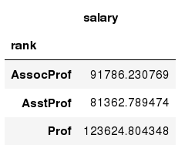
Data Frames groupby method
Once groupby object is create we can calculate various statistics for each group:
In [ ]:
#Calculate mean salary for each professor rank:
df.groupby('rank')[['salary']].mean()
Note: If single brackets are used to specify the column (e.g. salary), then the output is Pandas Series object. When double brackets are used the output is a Data Frame

Slide 40
Data Frames groupby method
groupby performance notes:
- no grouping/splitting occurs until it's needed. Creating the groupby object only verifies that you have passed a valid mapping
- by default the group keys are sorted during the groupby operation. You may want to pass sort=False for potential speedup:
In [ ]:
#Calculate mean salary for each professor rank:
df.groupby(['rank'], sort=False)[['salary']].mean()

Slide 41
Data Frame: filtering
To subset the data we can apply Boolean indexing. This indexing is commonly known as a filter. For example if we want to subset the rows in which the salary value is greater than $120K:
In [ ]:
#Calculate mean salary for each professor rank:
df_sub = df[ df['salary'] > 120000 ]
Any Boolean operator can be used to subset the data:
> greater; >= greater or equal;
< less; <= less or equal;
== equal; != not equal;
In [ ]:
#Select only those rows that contain female professors:
df_f = df[ df['sex'] == 'Female' ]

Slide 42
Data Frames: Slicing
There are a number of ways to subset the Data Frame:
one or more columns
one or more rows
a subset of rows and columns
Rows and columns can be selected by their position or label

Slide 43
Data Frames: Slicing
When selecting one column, it is possible to use single set of brackets, but the resulting object will be a Series (not a DataFrame):
In [ ]:
#Select column salary:
df['salary']
When we need to select more than one column and/or make the output to be a DataFrame, we should use double brackets:
In [ ]:
#Select column salary:
df[['rank','salary']]

Slide 44
Data Frames: Selecting rows
If we need to select a range of rows, we can specify the range using ":"
In [ ]:
#Select rows by their position:
df[10:20]
Notice that the first row has a position 0, and the last value in the range is omitted:
So for 0:10 range the first 10 rows are returned with the positions starting with 0 and ending with 9

Slide 45
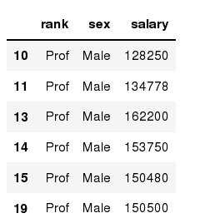
Data Frames: method loc
If we need to select a range of rows, using their labels we can use method loc:
In [ ]:
#Select rows by their labels:
df_sub.loc[10:20,['rank','sex','salary']]
Out[ ]:

Slide 46
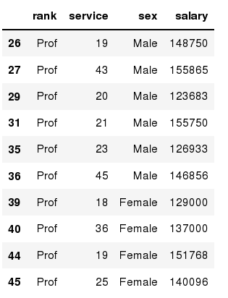
Data Frames: method iloc
If we need to select a range of rows and/or columns, using their positions we can use method iloc:
In [ ]:
#Select rows by their index:
df_sub.iloc[10:20,[0, 3, 4, 5]]
Out[ ]:

Slide 47
Data Frames: method iloc (summary)
df.iloc[0] # First row of a data frame
df.iloc[i] #(i+1)th row
df.iloc[-1] # Last row
df.iloc[:, 0] # First column
df.iloc[:, -1] # Last column
df.iloc[0:7] #First 7 rows
df.iloc[:, 0:2] #First 2 columns
df.iloc[1:3, 0:2] #Second through third rows and first 2 columns
df.iloc[[0,5], [1,3]] #1st and 6th rows and 2nd and 4th columns

Slide 48
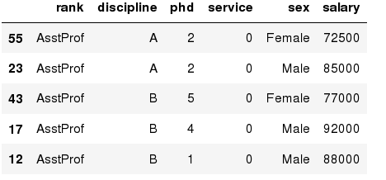
Data Frames: Sorting
We can sort the data by a value in the column. By default the sorting will occur in ascending order and a new data frame is return.
In [ ]:
# Create a new data frame from the original sorted by the column Salary
df_sorted = df.sort_values( by ='service')
df_sorted.head()
Out[ ]:

Slide 49
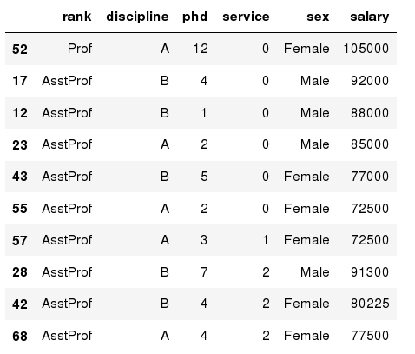
Data Frames: Sorting
We can sort the data using 2 or more columns:
In [ ]:
df_sorted = df.sort_values( by =['service', 'salary'], ascending = [True, False])
df_sorted.head(10)
Out[ ]:

Slide 50
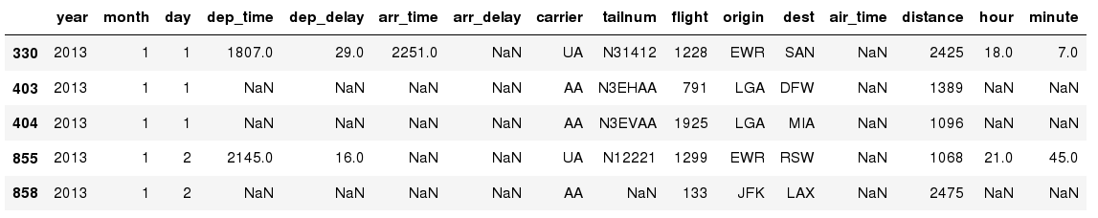
Missing Values
Missing values are marked as NaN
In [ ]:
# Read a dataset with missing values
flights = pd.read_csv("http://rcs.bu.edu/examples/python/data_analysis/flights.csv")
In [ ]:
# Select the rows that have at least one missing value
flights[flights.isnull().any(axis=1)].head()
Out[ ]:

Slide 51
Missing Values
There are a number of methods to deal with missing values in the data frame:
df.method() | description
dropna() | Drop missing observations
dropna(how='all') | Drop observations where all cells is NA
dropna(axis=1, how='all') | Drop column if all the values are missing
dropna(thresh = 5) | Drop rows that contain less than 5 non-missing values
fillna(0) | Replace missing values with zeros
isnull() | returns True if the value is missing
notnull() | Returns True for non-missing values

Slide 52
Missing Values
When summing the data, missing values will be treated as zero
If all values are missing, the sum will be equal to NaN
cumsum() and cumprod() methods ignore missing values but preserve them in the resulting arrays
Missing values in GroupBy method are excluded (just like in R)
Many descriptive statistics methods have skipna option to control if missing data should be excluded . This value is set to True by default (unlike R)

Slide 53
Aggregation Functions in Pandas
Aggregation - computing a summary statistic about each group, i.e.
compute group sums or means
compute group sizes/counts
Common aggregation functions:
min, max
count, sum, prod
mean, median, mode, mad
std, var

Slide 54
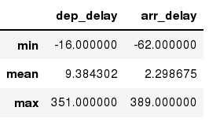
Aggregation Functions in Pandas
agg() method are useful when multiple statistics are computed per column:
In [ ]:
flights[['dep_delay','arr_delay']].agg(['min','mean','max'])
Out[ ]:

Slide 55
Basic Descriptive Statistics
df.method() | description
describe | Basic statistics (count, mean, std, min, quantiles, max)
min, max | Minimum and maximum values
mean, median, mode | Arithmetic average, median and mode
var, std | Variance and standard deviation
sem | Standard error of mean
skew | Sample skewness
kurt | kurtosis

Slide 56
Graphics to explore the data
Seaborn package is built on matplotlib but provides high level interface for drawing attractive statistical graphics, similar to ggplot2 library in R. It specifically targets statistical data visualization
To show graphs within Python notebook include inline directive:
In [ ]:
%matplotlib inline

Slide 57
Graphics
 | description
distplot | histogram
barplot | estimate of central tendency for a numeric variable
violinplot | similar to boxplot, also shows the probability density of the data
jointplot | Scatterplot
regplot | Regression plot
pairplot | Pairplot
boxplot | boxplot
swarmplot | categorical scatterplot
factorplot | General categorical plot

Slide 58
Basic statistical Analysis
statsmodel and scikit-learn - both have a number of function for statistical analysis
The first one is mostly used for regular analysis using R style formulas, while scikit-learn is more tailored for Machine Learning.
statsmodels:
linear regressions
ANOVA tests
hypothesis testings
many more ...
scikit-learn:
kmeans
support vector machines
random forests
many more ...

